Slide 1


Charge Injection System (CIS) Update
Katie Hughes, Dawit Belayneh
The University of Chicago
November 8, 2021

Slide 2
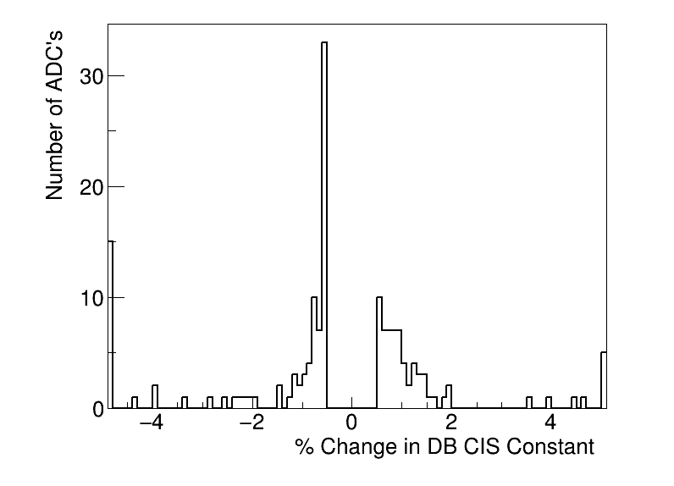
Summary
Updated on October 27
CIS runs from October 12 - October 25
159 channels in update
139 good
20 with >5% change
12 masked
8 affected

Slide 3
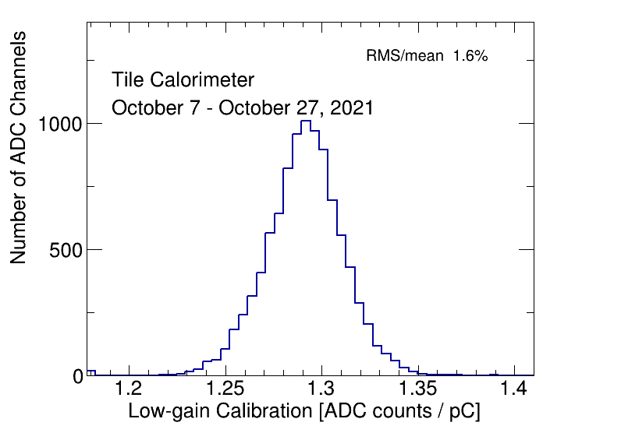
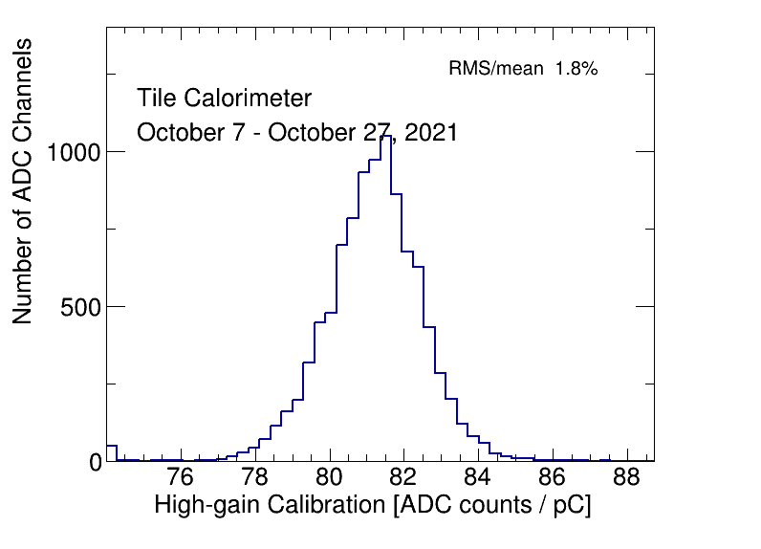
CIS constant distributions

Slide 4
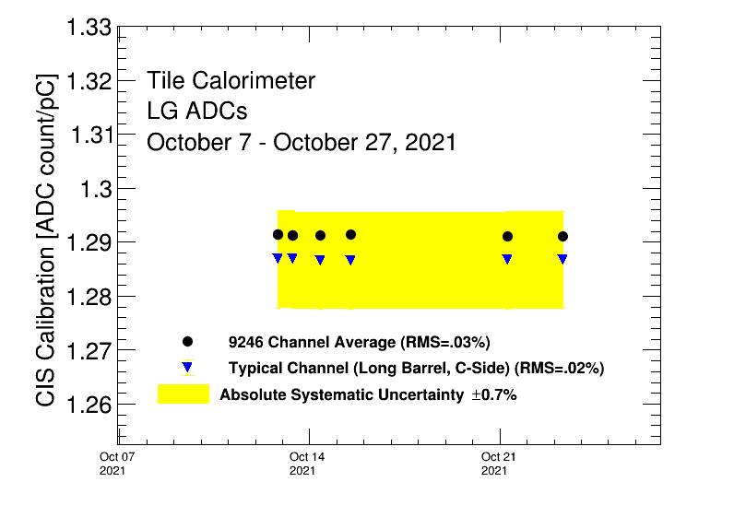
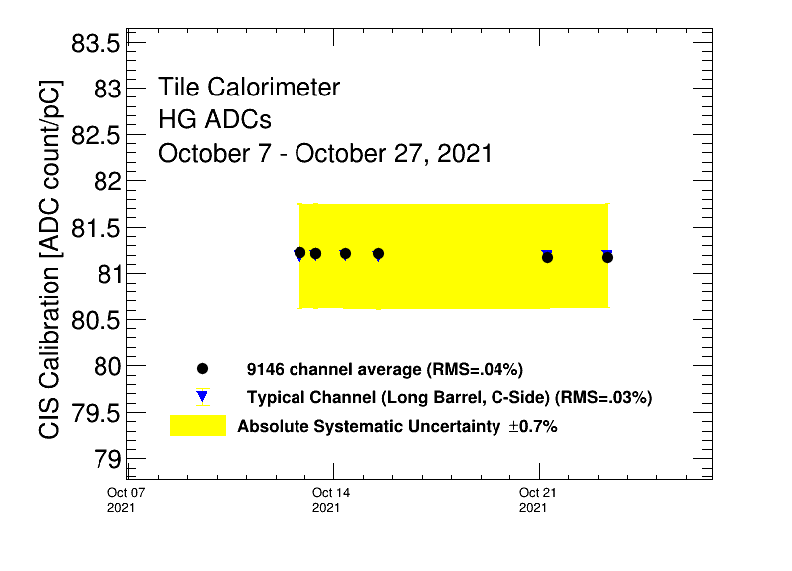
Detector stability

Slide 5
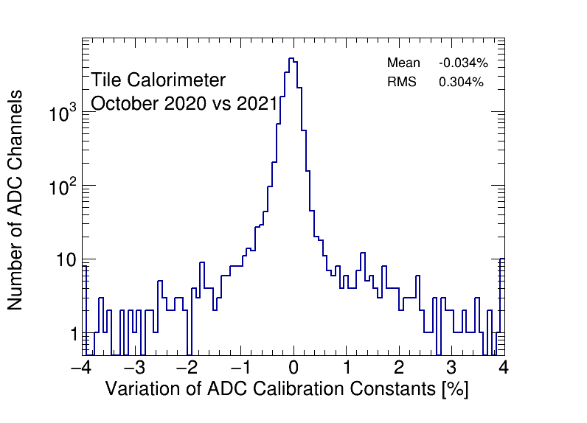
CIS constant stability

Slide 6
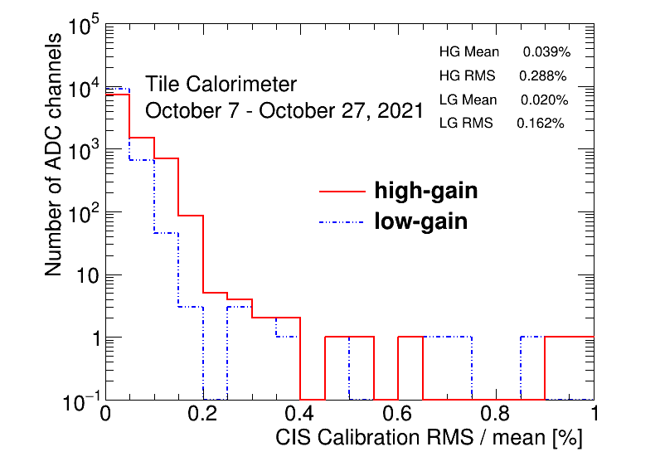
CIS constant RMS/mean

Slide 7
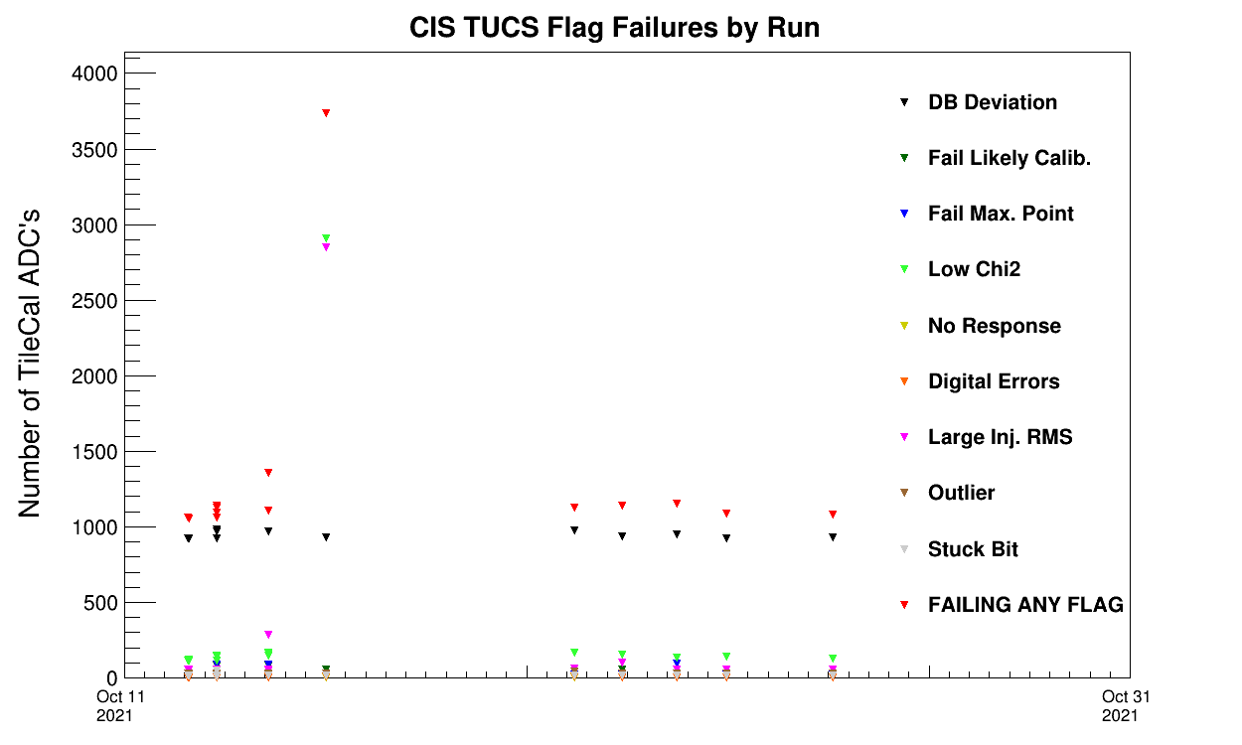
CIS TUCS Quality Flags
Run 404171
(Oct 15)
Notes:
LBA LG and HG has a slightly weird amp/charge for this run
LBC and EBC LG and HG has weird timing

Slide 8
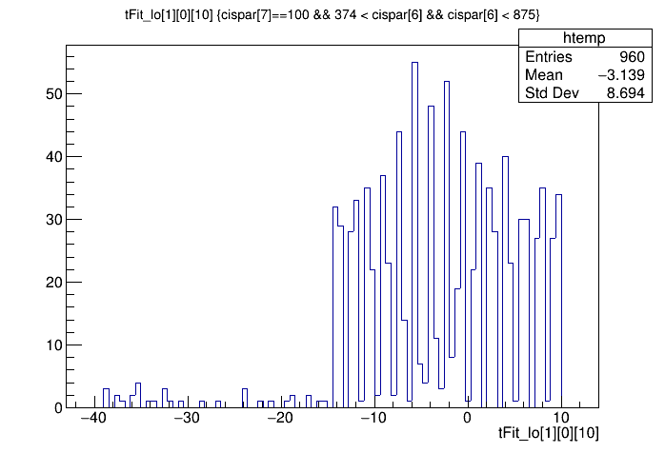
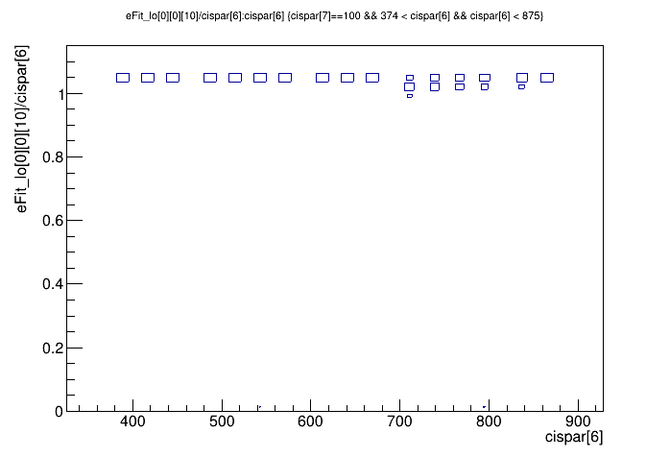
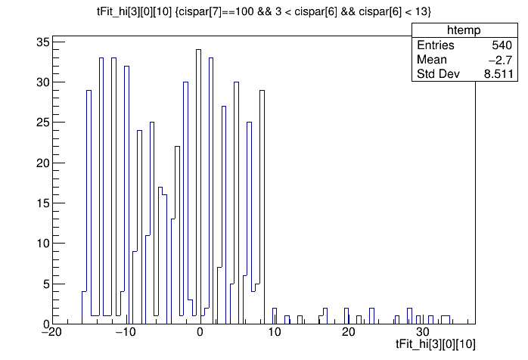
Run 404171
Amp/charge ratio is slightly off for LBA
Timing is slightly off for LBC and EBC
Doesn’t noticeably affect CIS constants, but this could affect the TUCS flags
LBC lowgain
LBA lowgain
EBC highgain

Slide 9
Run Selection
Initial date range for runs used was Sept. 29 - Oct. 27
Problem: Runs on Oct. 6 are outliers on every partition
Lots of bad timings and bad amp/charge ratios
Runs on Oct. 1 are also often bad
This gave us >8,500 channels to go examine by hand ☹
Solution: Start date range from Oct. 7
Now <400 channels to go through
After this, no consistent outliers across partitions
Runs used: 403569 403571 403574 403637 403640 403642 403645 403801 403804 403806 404171 404497 404604 404750 404843

Slide 10
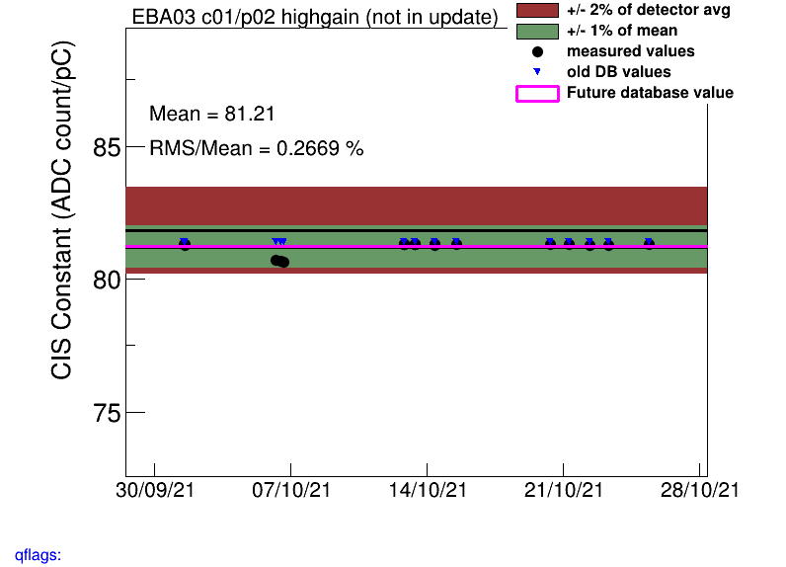
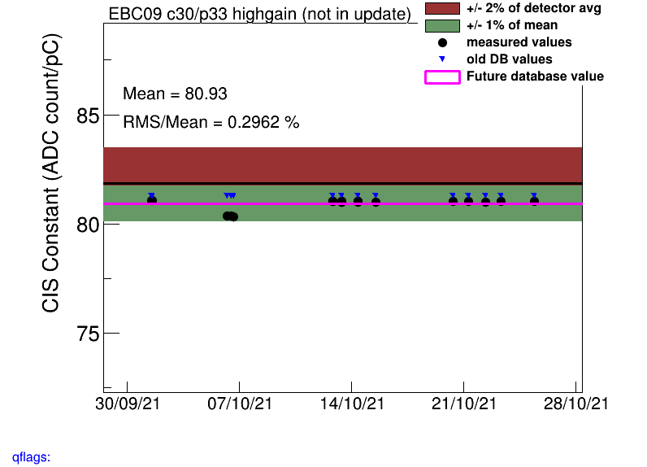
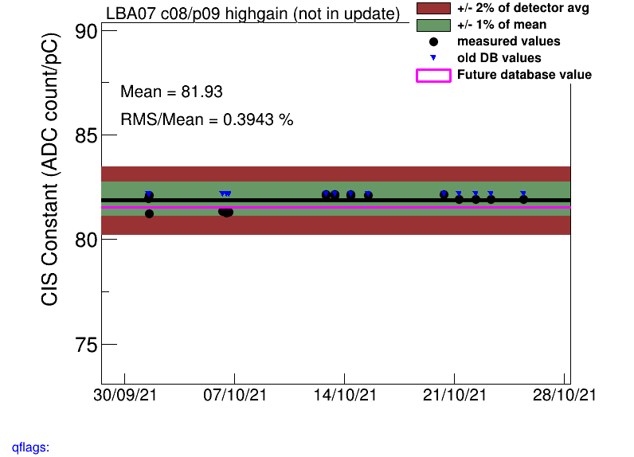
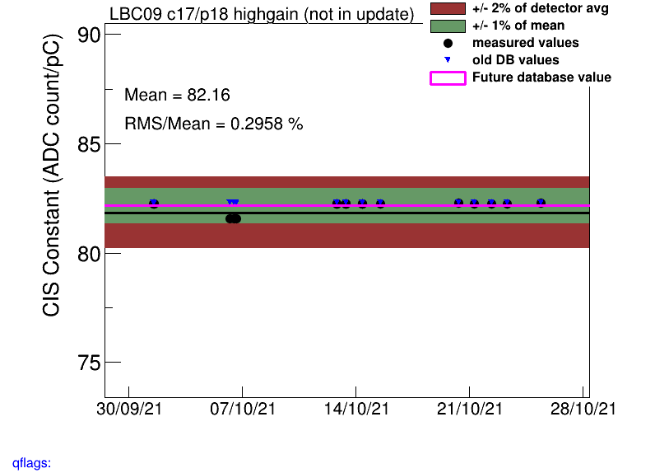

Slide 11
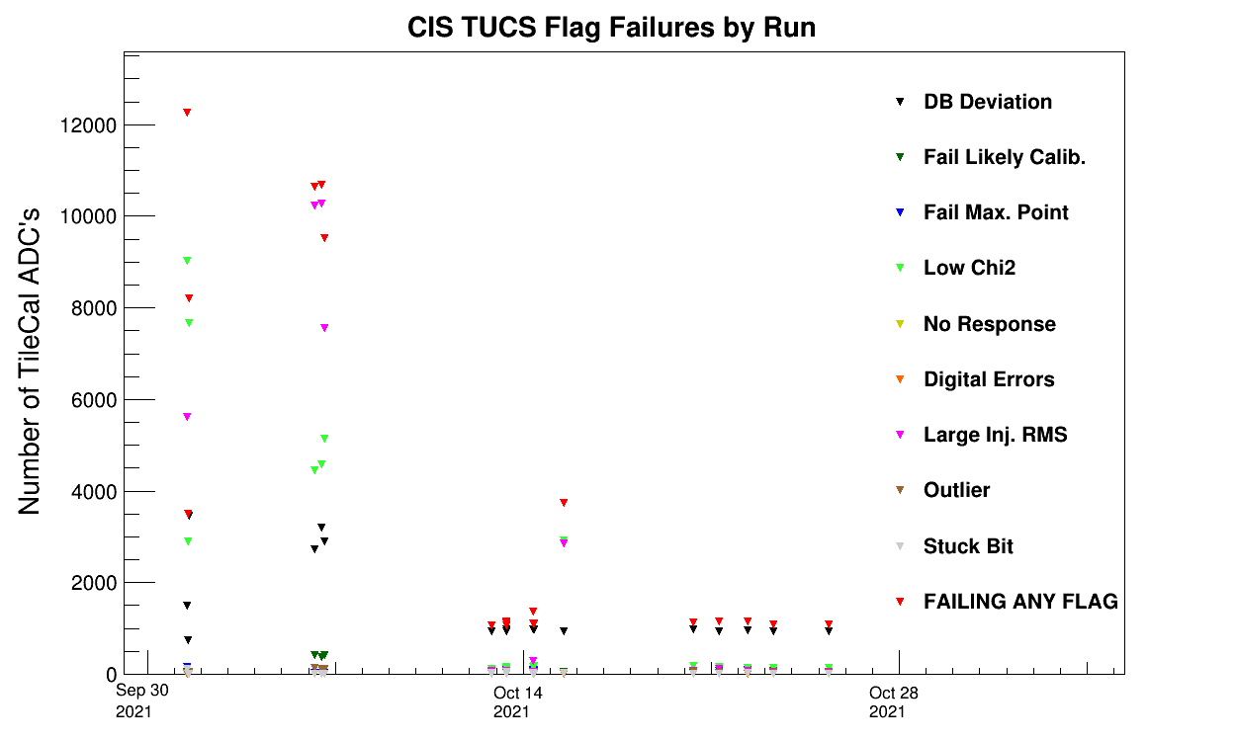

Slide 12
Interesting channel behaviour

Slide 13
High Deviation Channels
Highgain (Avg should be 81)
LBA_m64_c29_highgain: 75
LBC_m01_c25_highgain: 73
EBA_m06_c20_highgain: 75
EBA_m39_c31_highgain: 72
EBA_m49_c00_highgain: 72
EBA_m50_c31_highgain: 74
EBC_m23_c36_highgain: 69
EBC_m37_c40_highgain: 73
EBC_m43_c36-41_highgain: 55
LBA_m62_c26_highgain: 105
LBC_m52_c18_highgain: 112
Lowgain (Avg should be 1.29)
EBA_m07_c31_lowgain: 0.94
LBC_m08_c03_lowgain: 1.06
EBC_m26_c01_lowgain: 0.17
EBC_m43_c36-41_lowgain: 0.85
EBC_m56_c41_lowgain: 1.17
EBC_m58_c31_lowgain: 0.028
LBC_m23_c20_lowgain: 1.62

Slide 14
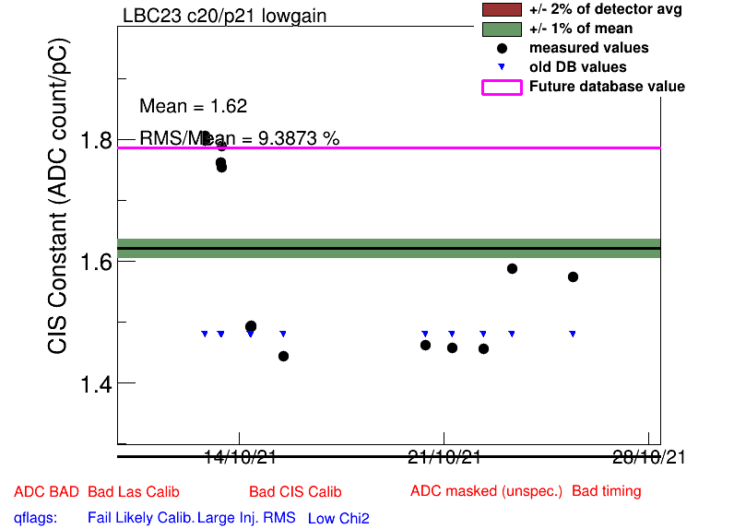
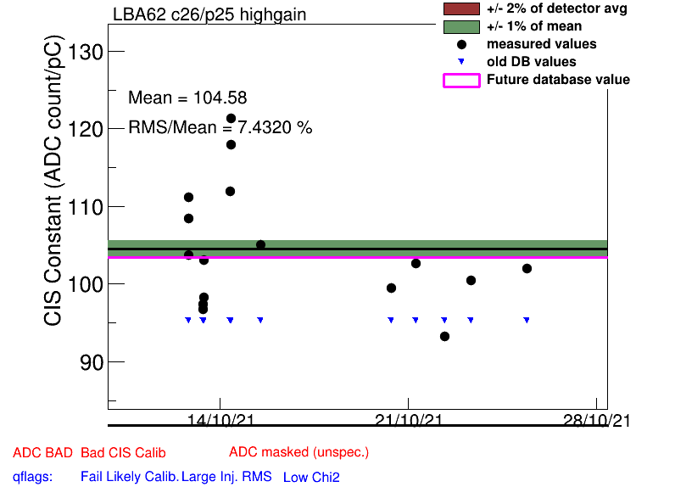
Some unusually high channels
LBC_m23_c20_lowgain
LBA_m62_c26_highgain

Slide 15
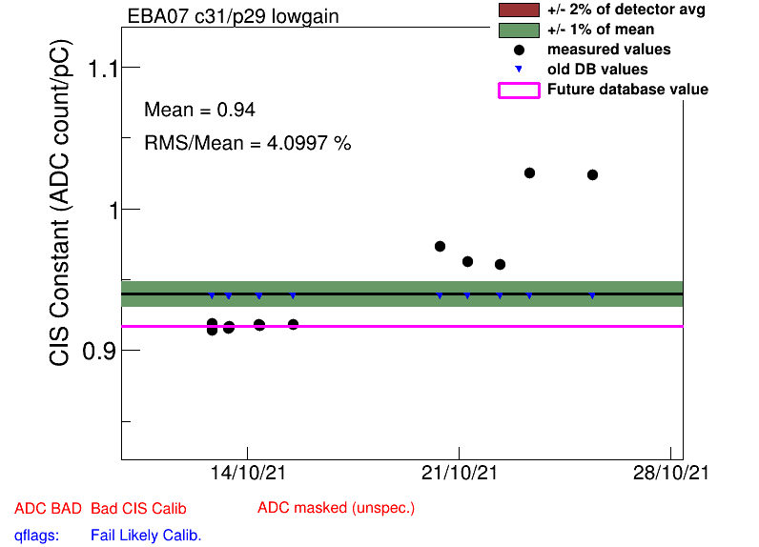
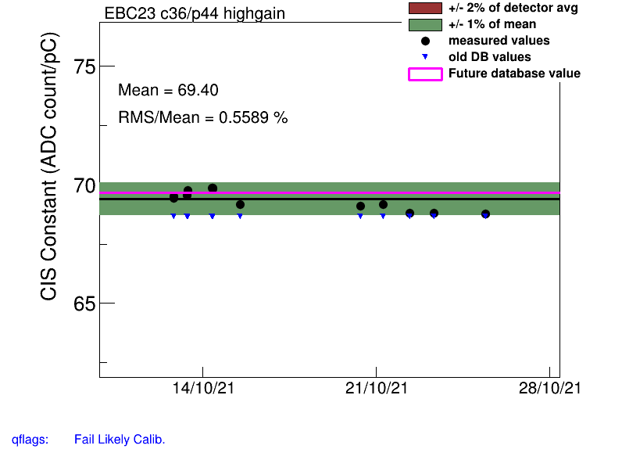
Some unusually low channels
EBA_m07_c31_lowgain
EBC_m23_c36_highgain

Slide 16
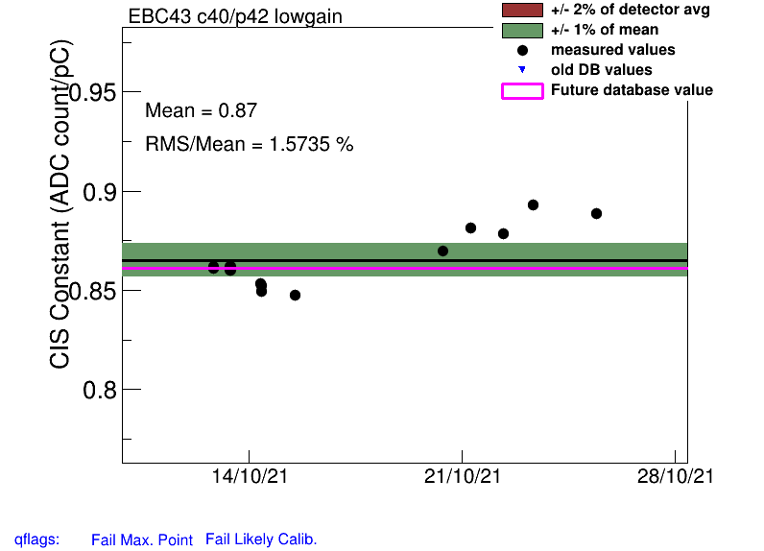
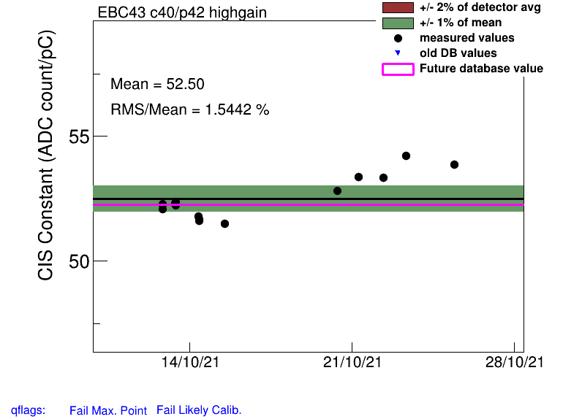
EBC_m43
Chs 36-41 on both gains are unusually low
Pattern of points is essentially identical across these channels
Marked as “minor problem” in the last DQ report

Slide 17
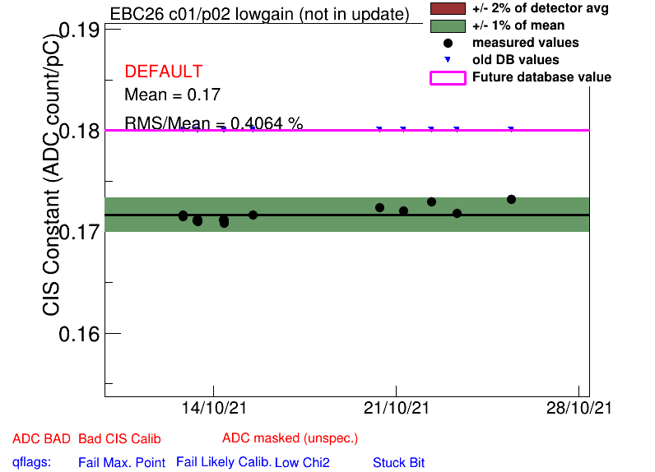
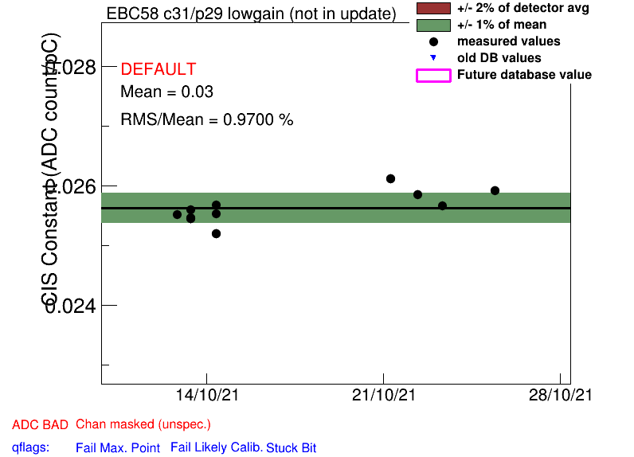
Channels close to zero
EBC_m26_c01_lowgain
EBC_m58_c31_lowgain
(marked in last DQ report)

Slide 18
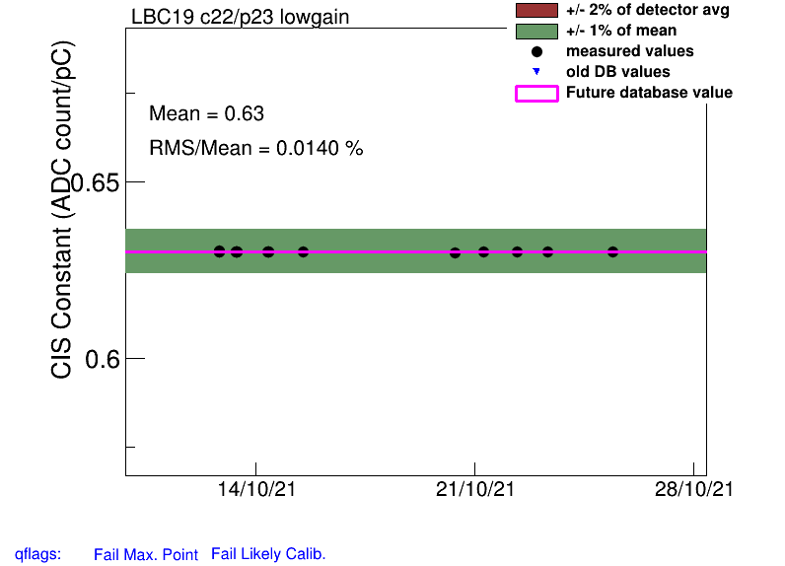
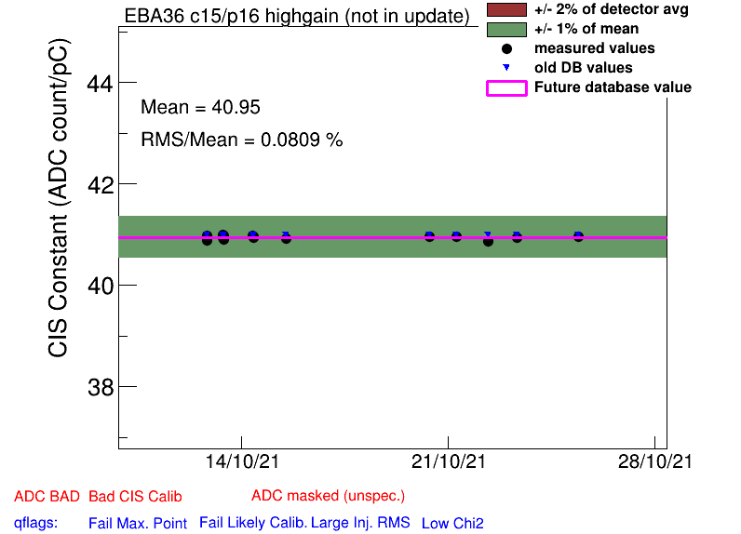
Half Gain Channels
EBA_m15_c08_highgain
EBA_m16_c00_highgain
EBA_m36_c15_highgain
EBA_m48_c31_lowgain
EBA_m64_c03_highgain
EBC_m09_c40_highgain
EBC_m18_c04_lowgain
EBC_m21_c36_lowgain
LBC_m19_c22_lowgain
LBC_m41_c25_highgain
LBC_m47_c35_lowgain

Slide 19
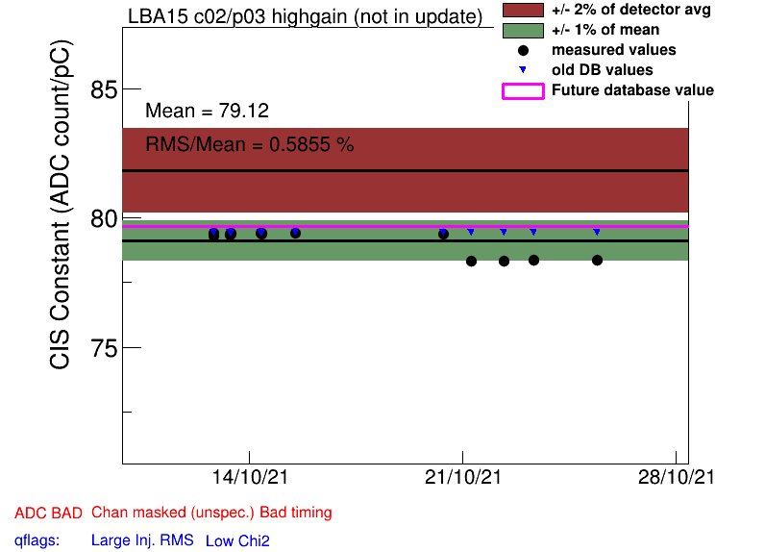
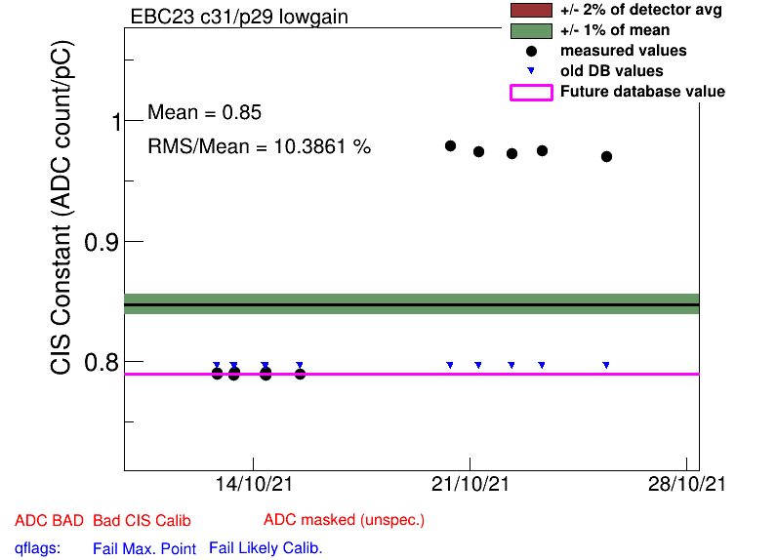
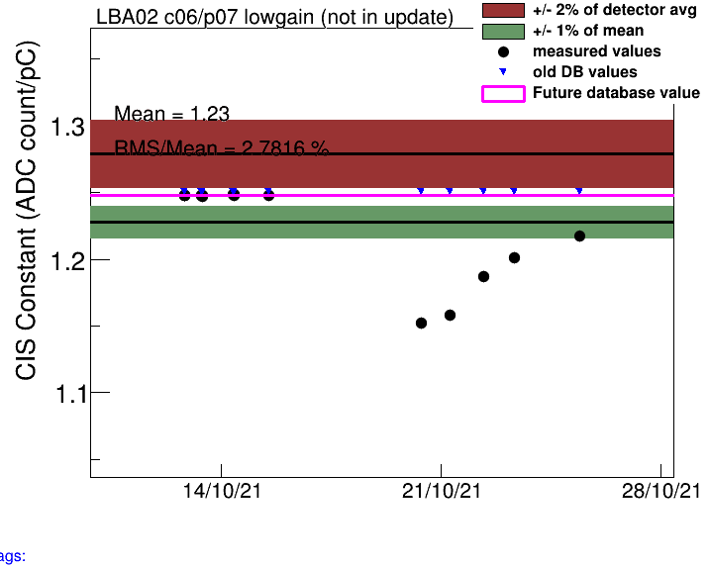
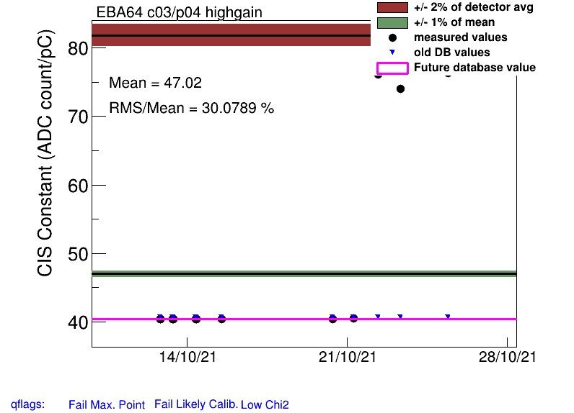
Constant Shifts
EBA_m64_c03_highgain: Oct. 20
EBC_m23_c31_lowgain: Oct. 20
LBA_m02_c06: Oct. 22
LBA_m15 : Oct. 21

Slide 20
COOL Flag Updates
Add BadCIS
EBA_m06_c20_highgain
EBA_m19_c41_highgain
EBA_m42_c30_highgain
EBA_m50_c31_highgain
EBA_m64_c03_highgain
EBC_m09_c40_highgain
EBC_m18_c04_lowgain
EBC_m18_c36_highgain
EBC_m23_c03_highgain
EBC_m23_c36_highgain
EBC_m30_c11_highgain
EBC_m43_c36-41_lowgain, highgain
EBC_m58_c31_lowgain
LBA_m02_c06_highgain
LBA_m02_c06_lowgain
LBA_m03_c17_lowgain
LBA_m21_c45_highgain
LBA_m43_c21_lowgain
LBA_m52_c02_lowgain
LBC_m13_c15_lowgain, highgain
LBC_m16_c29_highgain
LBC_m17_c11_highgain
LBC_m19_c22_lowgain
LBC_m44_c12_highgain
LBC_m47_c35_lowgain
LBC_m52_c18_highgain
LBC_m57_c06_highgain
LBC_m59_c26_highgain
LBC_m62_c08_highgain
LBA_m63_c24-35_highgain
Remove BadCIS
EBA_m03_c07_lowgain
EBA_m08_c07_lowgain
EBA_m08_c07_highgain
EBA_m34_c08_lowgain
EBA_m63_c36_lowgain
EBC_m11_c31_lowgain
EBC_m15_c04_lowgain
EBC_m18_c36_lowgain
EBC_m63_c07_highgain
EBC_m64_c31_lowgain
EBC_m64_c31_highgain
LBA_m07_c18_lowgain
LBA_m08_c46_lowgain
LBA_m18_c21_lowgain
LBA_m23_c11_highgain
LBA_m23_c36_lowgain
LBA_m40_c21_lowgain
LBA_m52_c36_lowgain
LBA_m53_c39_lowgain
LBA_m63_c05_highgain
LBC_m02_c23_highgain
LBC_m16_c20_highgain
LBC_m28_c04_lowgain
LBC_m40_c39_highgain
LBC_m46_c04_highgain
LBC_m48_c29_lowgain

Slide 21
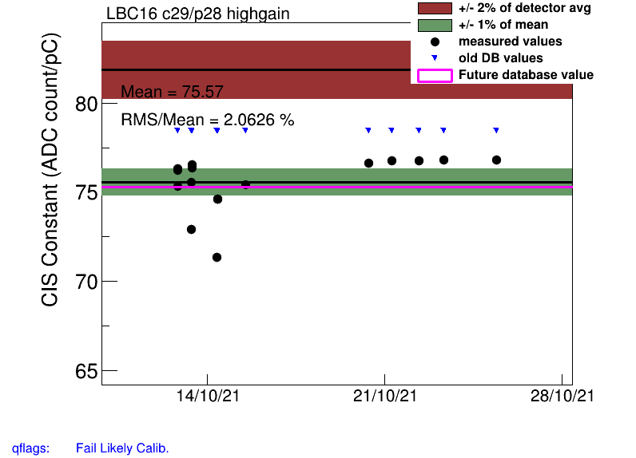
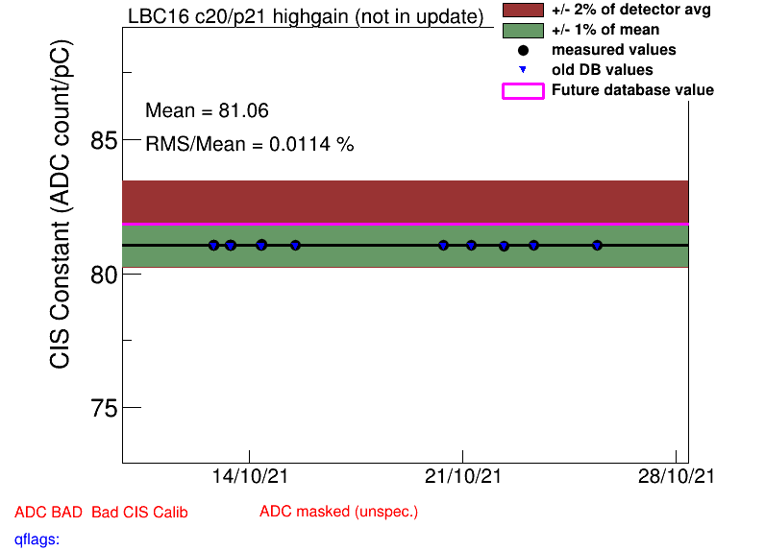
Add BadCIS
Remove BadCIS

Slide 22
Helpful links
Primary CIS tools (twiki)
Running a Monthly CIS Update (guide)

Slide 23
